Slide 1
CLOUD COMPUTING
What is it?
Notes:
I hear this question often. It is not easy to explain, because it means different things depending on who you talk to. Today’s Webinar will focus on the basics of what cloud computing is and what it means to the average library user and the library staff member.

Slide 2
THE AVERAGE CLOUD USER
Connects to the cloud via the Internet
  Does computing tasks, or
  Runs applications, or
  Stores Data
Notes:
I would bet everyone in attendance today uses the cloud. I am going to show a slide with several examples of cloud based applications. I would like you to count up how many from this sampling you use. I will then put up a poll question to get your answers.

Slide 3
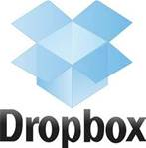

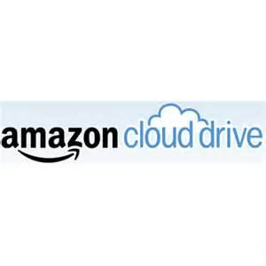



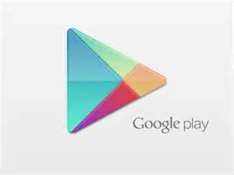









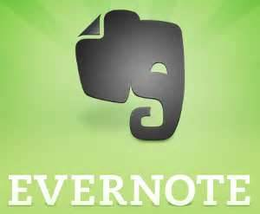





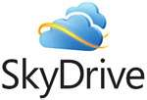
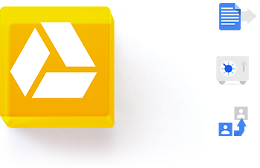

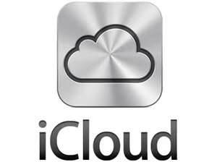









DO YOU USE THE CLOUD?
Notes:
Take the poll
Have you used the cloud
For one, two, three, or more of these services

Slide 4


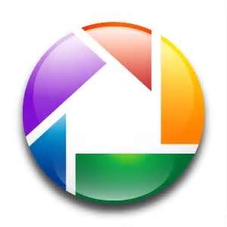



TYPE OF SERVICE
Software as a Service (SaaS) is a software distribution model in which applications are hosted by a vendor or service provider and made available to customers over a network, typically the Internet. http://searchcloudcomputing.techtarget.com/definition/Software-as-a-Service
Notes:
These items and many more, fall into the category of cloud computing called software as a service. Today’s presentation will focus on Software as a Service. There are other types of cloud computing and these will be briefly mentioned at the end of the presentation, but SaaS will be the primary topic today.

Slide 5
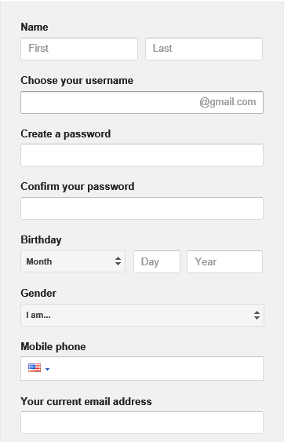
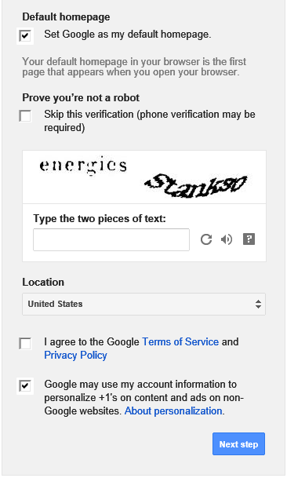
THE CLOUD REQUIRES
An Internet connection
An account - Created with a user name and a password
Agree to Terms
Notes:
The typical cloud software requires an account.
You are asked to fill out a form like the example here for Google Mail.
You also have to agree to the Terms of Service.
Raise your hand on the dashboard if you have checked agree to Terms of Service without reading.
Thanks for being honest. I highly recommend you go back and read those…you may learn some interesting things. The Privacy policies are also very revealing…check them out.

Slide 6
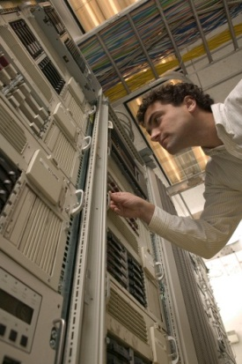

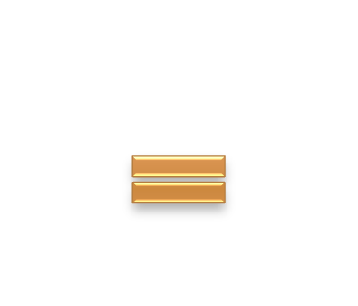

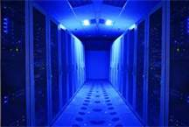
SO WHAT IS THE CLOUD?
Computing and software resources that are delivered on demand, as service.
(2013, January) A Walk in the Clouds. Cloud Computing, CDW-G Reference Guide., 3-5.
Notes:
An Internet connection is necessary for cloud computing
The cloud is actually a bunch of computer servers that store and transmit data
These servers are very large and can hold massive amounts of data
The servers can be housed anywhere in the world
A user accesses the data through a log-in

Slide 7
THE BACK STORY
From ground to cloud
Notes:
To understand how we got into the cloud, you need to understand a little about computer storage.

Slide 8
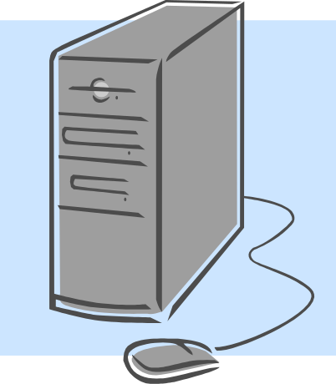

COMPUTER STORAGE
Computers have internal or hard drive storage(C: Drive)
CPU has a drive for storing programs, documents, pictures, videos, presentations, etc…
Inside the Computer
Standard Computer Tower or Central Processing Unit (CPU)

Slide 9

INTERNAL STORAGE
Content is stored on THAT computer
To use content must return to THAT computer
Cannot access this content from another device or computer

Slide 10
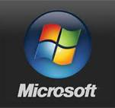
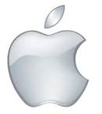


PROGRAMS
Purchase programs
Load to the computer
Each computer would need the program loaded and stored on the internal drive

Slide 11
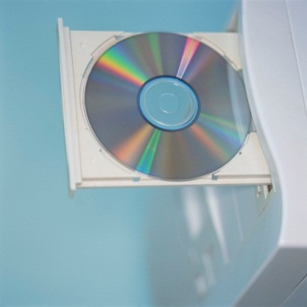

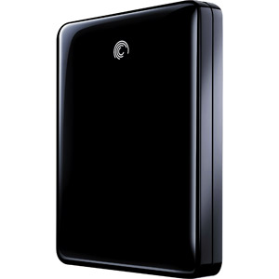
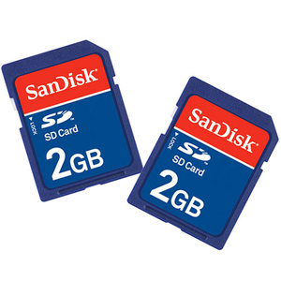
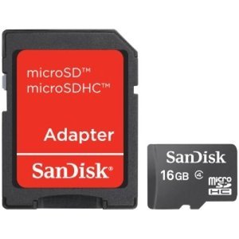
EXTERNAL STORAGE
Allows your content to become mobile
Save to the storage device
Take device to any compatible computer
Open and use content
CD/DVD
Thumb Drive
External Hard Drive
SD Card
Micro SD Card
Notes:
In addition to internal storage we have external storage. This comes in many shapes and sizes as you can see from the examples on this slide.

Slide 12
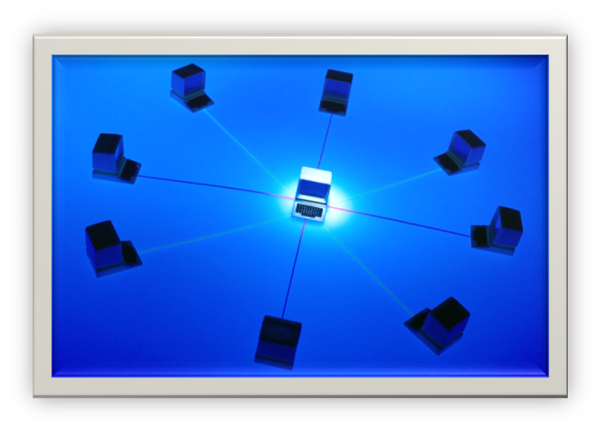
NETWORKED STORAGE
Multiple work stations talk to one unit that stores information and data.
Data is not saved to the C: drive, but to a network drive
Can retrieve the data stored to the network from any of the connected workstations.
Notes:
We also use networked storage which is more commonly found in businesses and organizations.
Still internal to the organization

Slide 13
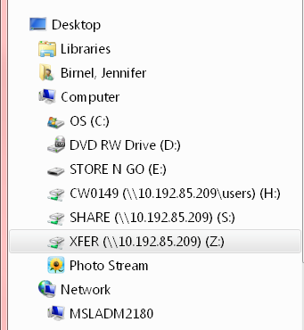
SAVING DOCUMENTS
When you do a “save as” on your computer, you choose where to save the material.
Internal Storage
External Storage
Network

Slide 14

CLOUD STORAGE
Create an Account – User name and password
Content lives with the account in the cloud
Log onto any computer with Wi-Fi to find your content
Notes:
Each brand of cloud storage offers different levels of service. You can find your content and read it from any device with an Internet connection, but you may not be able to edit it from any computer.

Slide 15

DOWNLOADS FOR STORAGE
Download a cloud based app to a computer you own
The app lives on your Computer
Save files to the app
When connected to the Internet it will sync with the cloud
The Cloud can be accessed from any Internet connection
Notes:
Some of these services offer an app download that adds a storage folder to your computer. Some services require that you download the app.

Slide 16
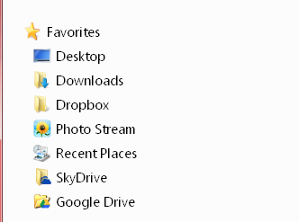
SAVE FILE AS
Do “save as” to save a file to your computer and the cloud
The syncing folders makes data retrieval easier
Box and DropBox require this download to work
Notes:
If you have downloaded apps you will see the folders associated with the application when you do a “save as” on your computer.
If I go to a Public Computing Center in library. Logon to a computer and open an Internet browser, I can go to Box.com or dropbox.com and sign into my account. I can open and view all my files, but I can’t make changes to the file.

Slide 17
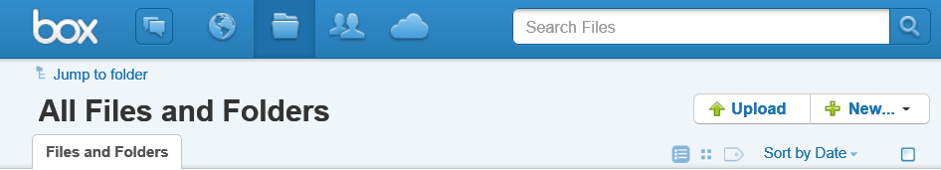
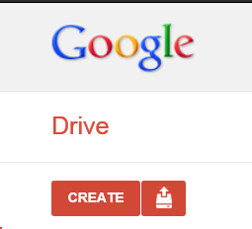

UPLOAD DOCUMENTS
Log-in to the online storage account
Click upload a file
Find the file on hard drive, network, or external storage
Upload to cloud storage
2 GB
5 GB
7 GB
5 GB
Notes:
I am curious to know how many people in attendance are using one of the types of cloud storage. I will launch a poll to get your input. I am also wondering what you like about the cloud storage service you use. Please type this response into the chat box.

Slide 18
MORE THAN STORAGE
Software and applications
Notes:
We will keep using the same four examples to discuss applications, for sake of ease.

Slide 19
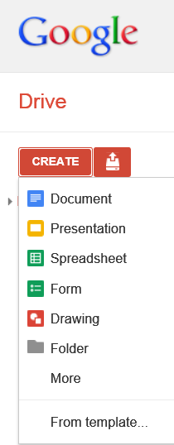
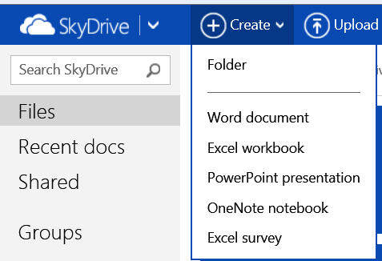
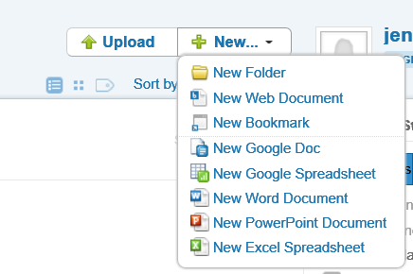

DOCUMENT CREATION
Google Docs
SkyDrive
Box
Notes:
Some cloud storage services also offer document creation services.

Slide 20
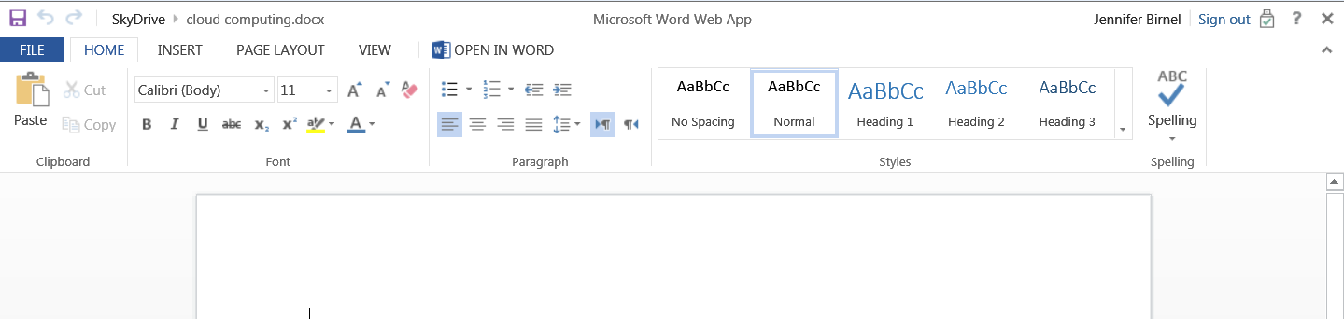
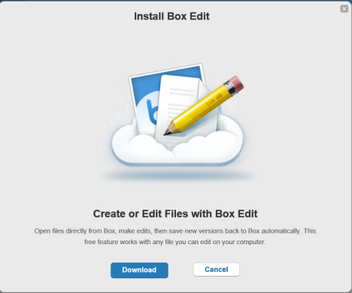
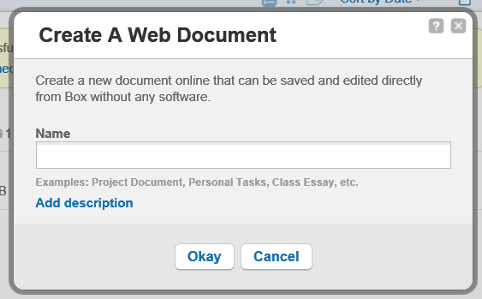
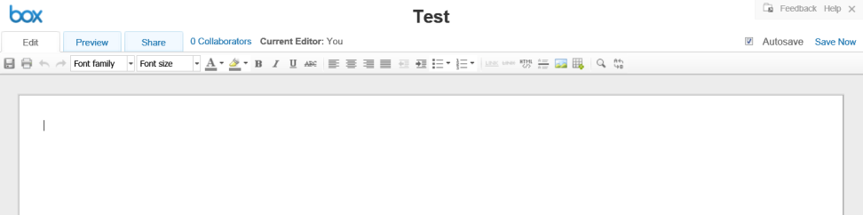
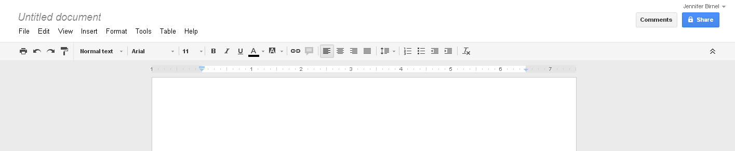
DOWNLOAD REQUIRED?

Slide 21

INTERNET IS REQUIRED
Creation is happening in the cloud
Saving is going to the cloud
To retrieve files, must return to the cloud

Slide 22
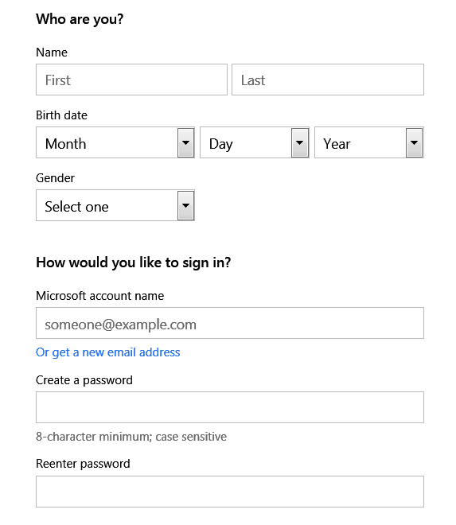
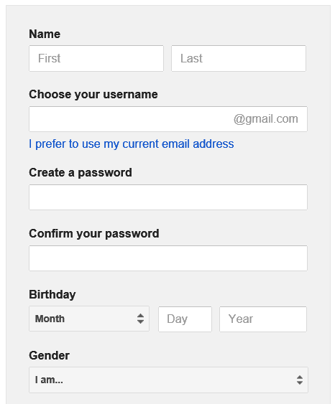
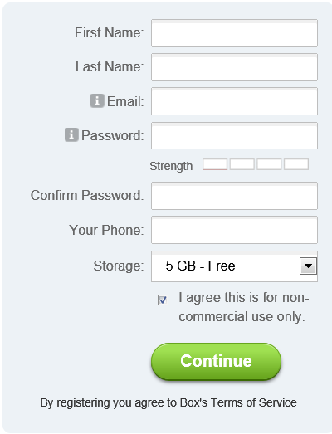
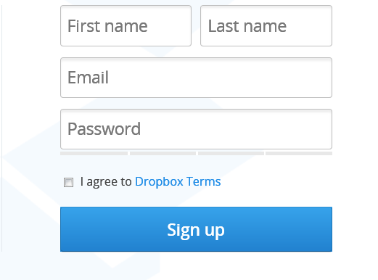
IMPLICATIONS
What are we comfortable with patrons using?
Notes:
These applications require setting up an account. You do not need a Microsoft mail or Gmail account to use. You can use your existing email to create a login.

Slide 23
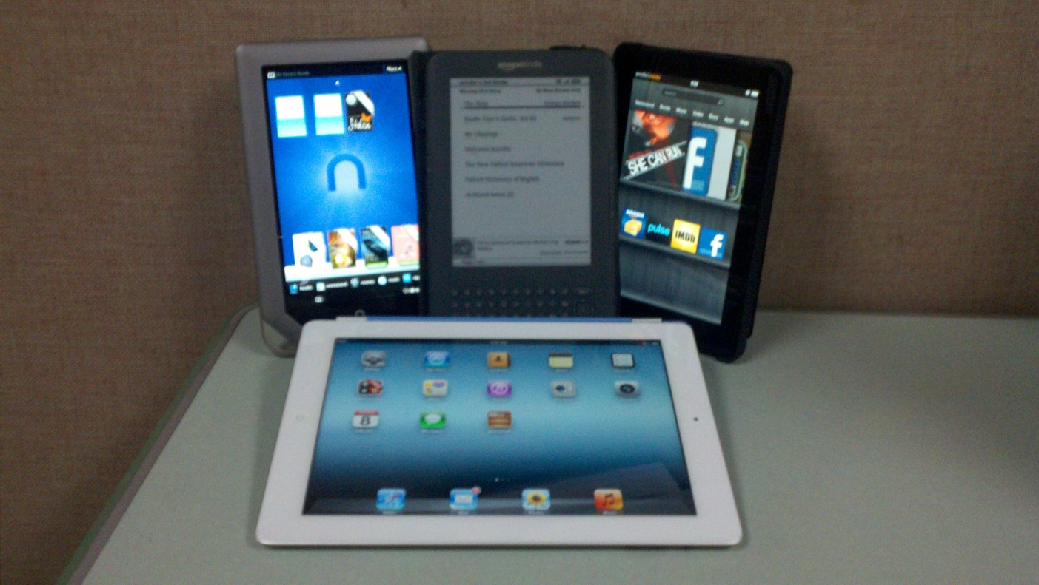
INTERNET CAPABLE DEVICES

Slide 24

BENEFITS
Saving Large Files
Multiple file types – Photos, videos, presentations, docs
Back-up of stored files
File Sharing
Access from devices
Nothing to forget (thumb drive, cd)
Project collaboration

Slide 25
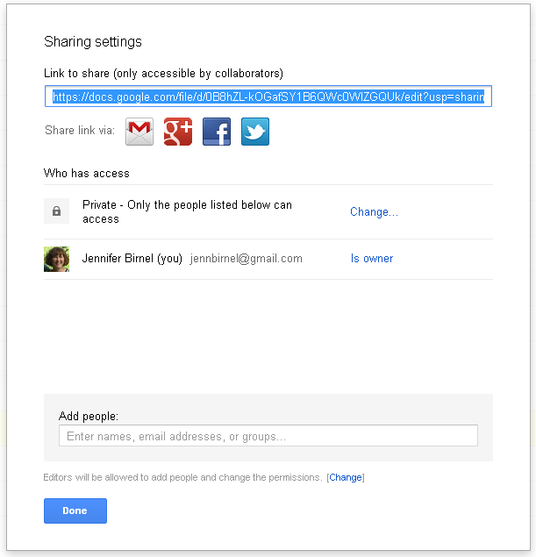
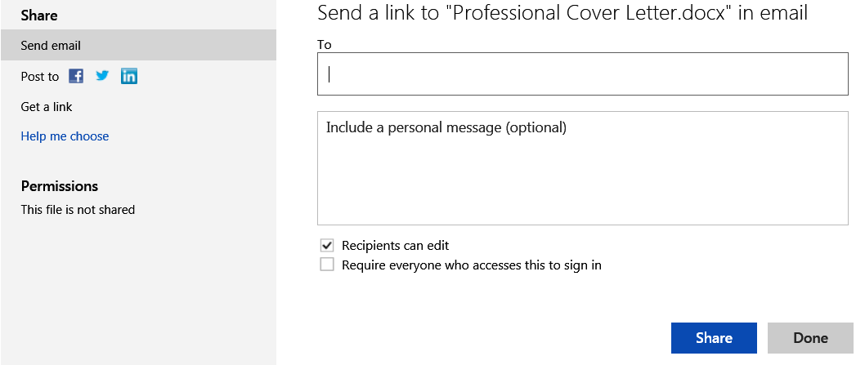
FILE SHARING
Notes:
Cloud storage allows you to share files with anyone. Files can be made public, for anyone to search and find or it can be shared with one person and you can decide if the people the file is shared with can view or edit the file.

Slide 26

OTHER SOFTWARE SERVICES
Photo editing software
Online banking apps
Social media apps
Communication

Slide 27
LIBRARY SPECIFIC SERVICES
WorldCat
MSC
Ebsco
Discover It

Slide 28
OTHER CLOUD SERVICES

Slide 29
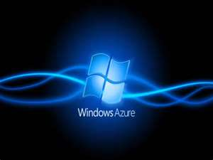

TYPES OF SERVICE
Platform as a Service (PaaS) is a way to rent hardware, operating systems, storage and network capacity over the Internet. The service delivery model allows the customer to rent virtualized servers and associated services for running existing applications or developing and testing new ones. http://searchcloudcomputing.techtarget.com/definition/Platform-as-a-Service-PaaS

Slide 30
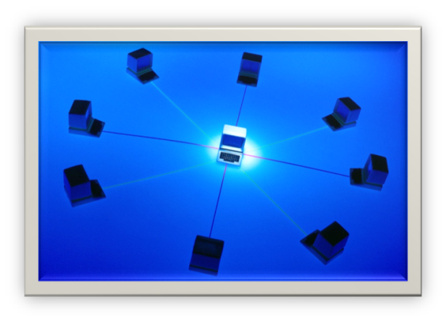
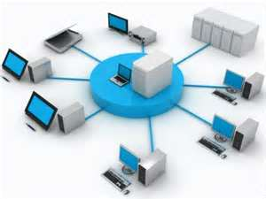
TYPES OF SERVICE
Infrastructure as a Service (IaaS) is a provision model in which an organization outsources the equipment used to support operations, including storage, hardware, servers and networking components. The service provider owns the equipment and is responsible for housing, running and maintaining it. The client typically pays on a per-use basis. http://searchcloudcomputing.techtarget.com/definition/Infrastructure-as-a-Service-IaaS
Notes:
These services are complex and require research and IT knowledge to pursue. They can be well worth the effort for many organziations.

Slide 31
WHY THE CLOUD?

Slide 32
ADVANTAGES
Can be less expensive compared to buying software and hardware
Can be used from any computer or device with an Internet connection
The device does not need as large of an internal storage system
Compatible with most computers and operating systems
Updates occur across the service

Slide 33
DISADVANTAGES
Security Issues
Terms of Service
Privacy Policies

